Slide 1
Supervised and Unsupervised learning Statistics and Sampling
Mr. Shrikrishna Anand Narvekar
Assitant Professor
Computer Engineering department
Agnel Institute of Technology and Design

Slide 2
Supervised Learning
Models are trained using labelled data i.e. input data used is for training it is paired with corresponding output labels.
Supervised learning needs supervision to train the model
Image Classification:
Input: Images of animals (e.g., cats, dogs, birds).
Output Label: The type of animal in the image (e.g., "Cat," "Dog," "Bird").

Slide 3
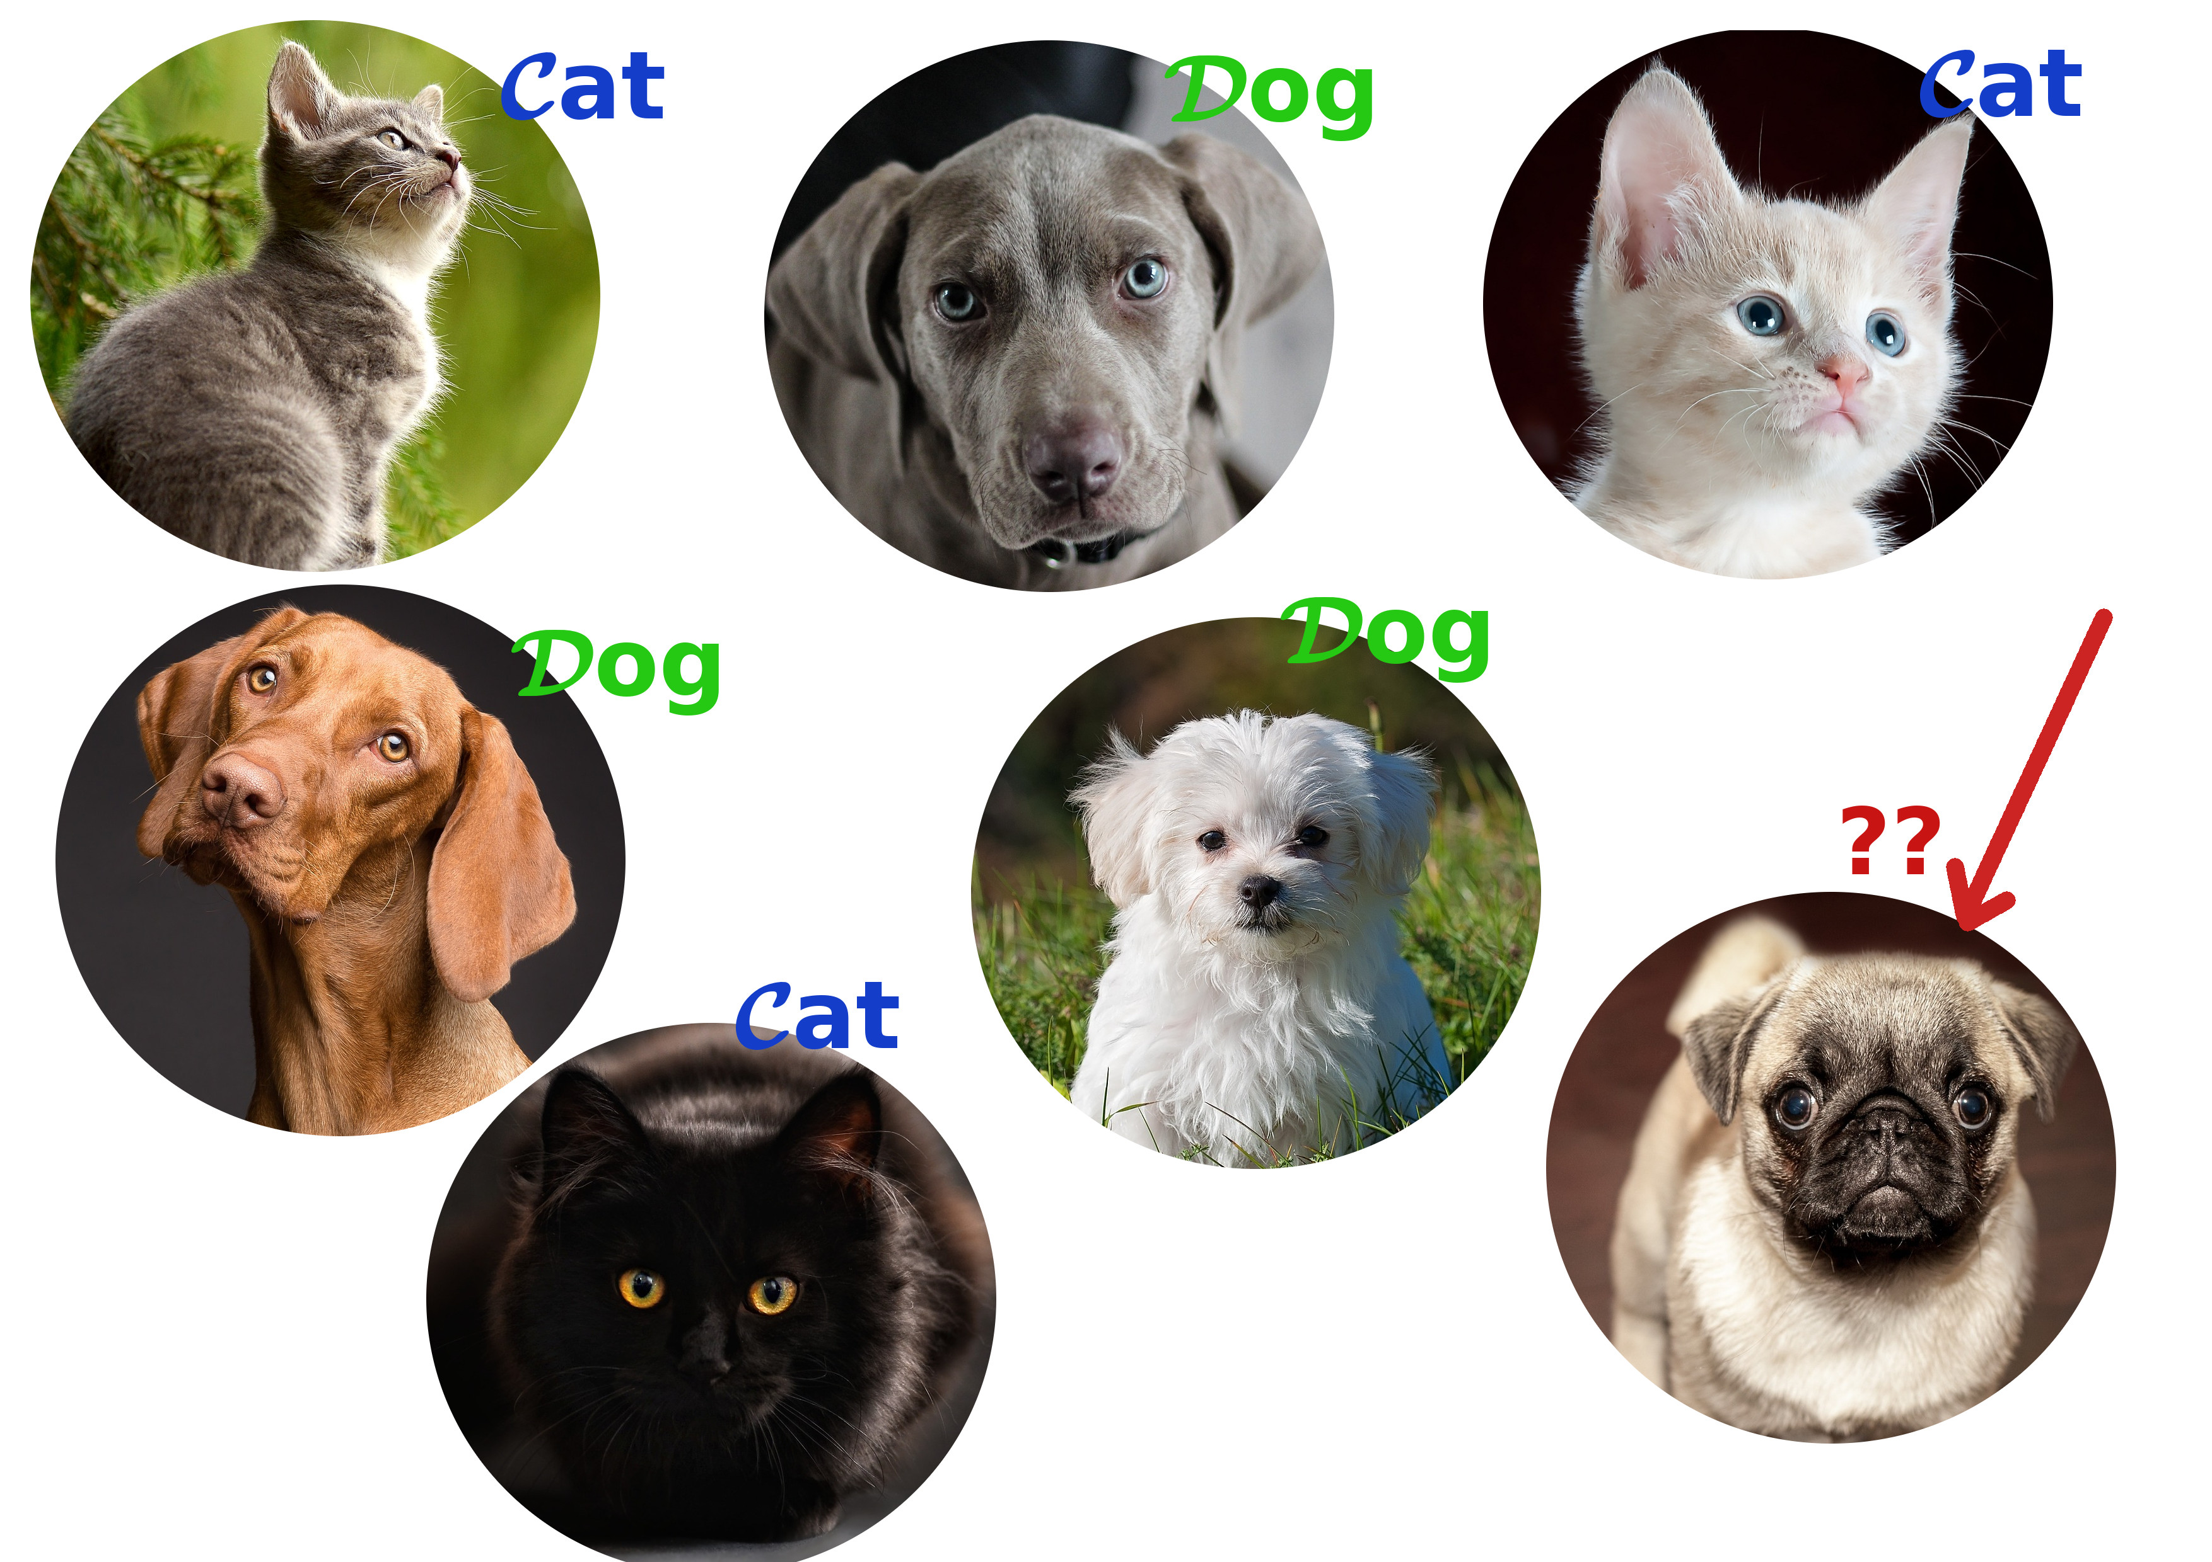

Supervised Learning

Slide 4
Unsupervised Learning
Patterns inferred from the unlabelled input data
To find the structure and patterns from the input data
Unsupervised learning does not need any supervision. Instead, it finds patterns from the data by its own.

Slide 5
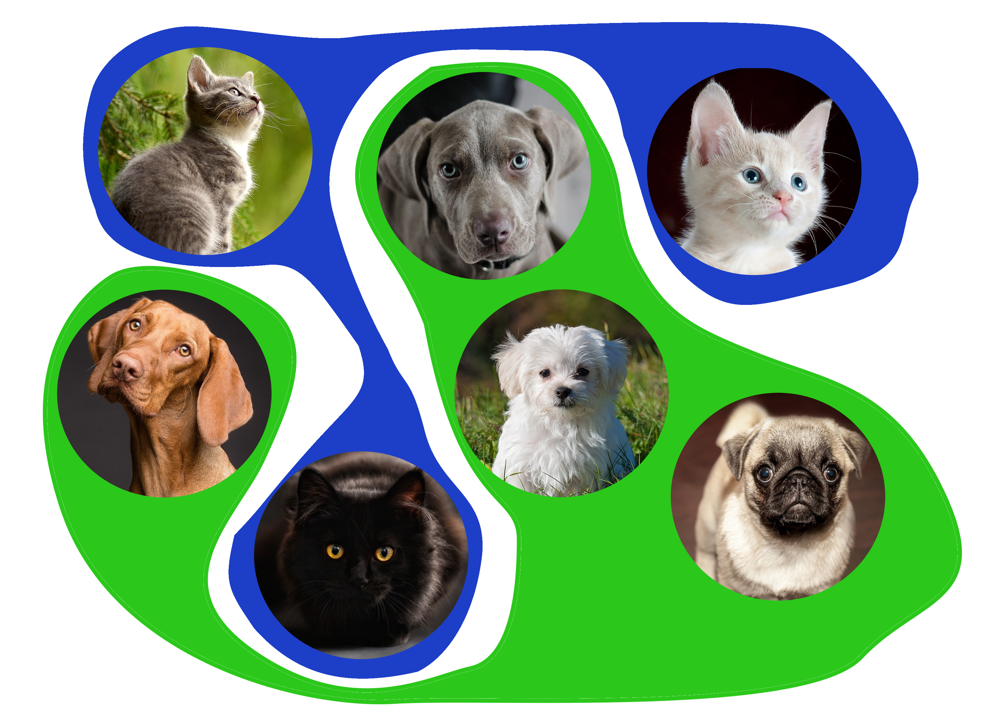
Unsupervised Learning

Slide 6

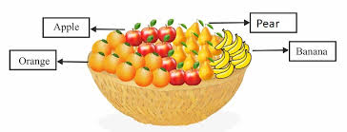
Unsupervised Learning

Slide 7
Distinguish between Supervised and Unsupervised learning Methods in data analytics
Supervised Learning | Unsupervised Learning
Trained using labelled data | Trained using unlabeled data
Input data is provided to the model along with the output labels. | Only input data is provided to the model.
goal of supervised learning is to train the model so that it can predict the output when it is given new data | The goal of unsupervised learning is to find the hidden patterns and useful insights from the unknown dataset
Typically used for regression(predicting continuous values) and Classification (predicting categorical values) | Commonly used for clustering (grouping similar items), association (finding relationships between variables), and dimensionality reduction (reducing the number of variables).
The output is typically a specific prediction or classification based on the labelled data. | The results are generally more exploratory and descriptive.

Slide 8
What are statistics
Statistics (a discipline) is a science of dealing with data.
It consists of tools and methods to collect data, organize data, and interpret the information or draw conclusion from data.
In context of data analytics , statistics serve as the foundation for making data-driven decisions.

Slide 9
Basic Terms
Population: A collection, or set, of individuals or objects or events whose properties are to be analyzed.
Sample: A subset of the population.
Parameter: A numerical value summarizing all the data of an entire population , for instance, a population mean.
Statistic: A numerical value summarizing the sample instance, a sample mean.

Slide 10
Two areas of statistics
Statistics is broadly divided into two main areas: Descriptive Statistics and Inferential Statistics.
Scores: 85, 78, 92, 88, 76, etc.
descriptive statistics is used to calculate mean, median , mode, range,
Standard deviations
You can use bar chart, histogram to visualize data and get insights from it

Slide 11
Inferential statistics
It involves using sample data to make predictions or draw conclusion about large population.
Example: Suppose you want to know average height of all students in a university (Population). Then it is not practical to take sample of 100 students and find their average height i.e. 170cm. Using inferential statistics you can use this sample data to estimate average height of all students in the university.
You might calculate confidence interval to say “ We are 95% confident that the average height of all students at the university is between 168cm to 170 cm.

Slide 12
Variable
Variables are characteristics or properties that are recorded for each individual or object in study or dataset. It represents different attributes or pieces of information that we collect to understand , analyze and draw conclusion about the data.
Variables can be quantitative (Numeric) or qualitative(Categorical)

Slide 13
Variables
Qualitative
Quantitative
Nominal
Ordinal
Discrete
Continuous

Slide 14
Quantitative variables
These variables can be measured or counted. Further divided into two types: Discrete and continuous
Discrete variables: Countable numbers, typically integers
Number of children: how may children each family has. 0,1,2,3 etc
Number of courses taken: how many courses student has enrolled. 1,2,3
Continuous variables: Measurable quantities that can take any value.
Variable named “Height” (170.5 cm,162.3cm)
Weight (60.5 kg,72.8 kg)

Slide 15
Qualitative variables
Variables represents categories or labels used to describe non-numerical attributes or qualities.. They can be either nominal(no specific order) or ordinal(having specific order).
Nominal : do not have specific order
Gender records each person is “Male” or “Female”
Favorite color: Like “Red”, “Blue”, “Green”
Ordinal : Categories have specific order
Educational level: “High School”, “Under graduate”, “Post Graduate”,
Satisfaction rating: Customer satisfaction like “satisfied”, “unsatisfied”

Slide 16
Exercise
Tell me if the variables mentioned below are what type?
Employee ID:
Age
Department
Years of experience
Job satisfaction level
Salary

Slide 17
Data Collection
First Problem statistician faces is how to obtain data.
Usually the data are sample data collected from a portion of the population. It is important to obtain good representative sample data.
Statistical Inferences: Once a good, representative sample is obtained, statistician use the information from sample data to make conclusion or predictions about the entire population.

Slide 18
Biased sampling
Biased sampling method is one that produces data that is not truly representative of the whole population
Unbiased sampling provides sample which is fair representation of the population

Slide 19
Biased sampling
Leads to incorrect or misleading results. Two common type of biased sampling methods are:
Convenience sample: Sample selected from elements of a population that are easily accessible.
Volunteer sample: sample collected from those elements of the population which chose to contribute the needed information on their own initiative

Slide 20
Unbiased sampling
It gives every member of the population an equal chance of being selected. This leads to a sample that more accurately reflects diversity and characteristics of whole population.
Example of unbiased sampling is
Random sampling: Select people randomly from entire population, like drawing names out of hat, ensures everyone has equal chance of being chosen making sample more likely to be representative of the whole population

Slide 21
Sampling
Select smaller portion(sample S) from a larger dataset N to represent the entire dataset.
Why is sampling useful?
Efficiency: Running algorithm on entire dataset can be slow and computationally expensive. By taking a smaller representative sample time and resources required is reduced.
Complexity: Allows some algorithms to run more efficiently, with complexity which is potentially sub-linear to the size of data i.e. it does not increase as quick as size of data

Slide 22
Key principle
Representative sample: Sample you choose should reflect characteristics of entire population. If it is not so then analysis may be misleading.
Simple random sampling is the most basic method, where each data has equal chance of being selected. It may lead to poor result if data is skewed.
When data is skewed then adapting methods like stratified sampling is used. In stratified sampling data is divided into different groups based on certain characteristics and then sample is taken from each group

Slide 23
How should we choose samples
Probability sampling: Each member of the population has a chance of being selected . It is mainly quantitative approach.
Non-Probability sampling: Not all samples have equal chance of participating in the study.
Our focus is on probability sampling

Slide 24
Probability sampling
Simple random sampling
Systematic sampling
Stratified sampling
Proportional sampling
Cluster Sampling

Slide 25
Simple random sampling
Every data point in the dataset has an equal probability of being selected
Easy to implement
Obtained either by sampling with replacement from finite population
Without replacement from infinite population

Slide 26
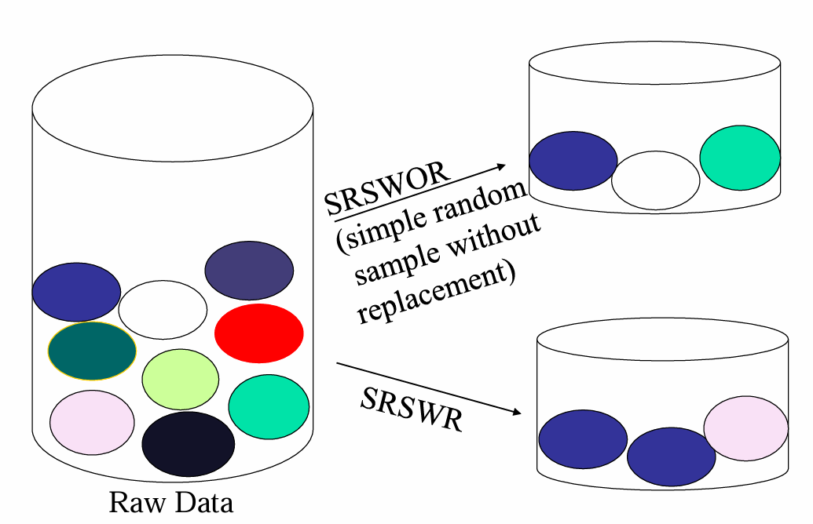
Sampling without replacement

Slide 27
Example of simple random sampling
Suppose you have small dataset consisting of following 10 students each represented by their student IDs: 1,2,3,4,5,6,7,8,9,10. Each have equal chance of being selected . What is the probability of selecting one student?
We have randomly selected any 4 IDs two times and result is as shown below
First time Student ID: 3,7,1,10
Second time Student ID: 3,7,3,10

Slide 28
Systematic sampling
A sample in which every kth item of the sampling frame is selected, starting from the first element which is randomly selected from the first k elements.
Note: The systematic technique is easy to execute. However, it has some inherent dangers when the sampling frame is repetitive or cyclical in nature. In these situations the results may not approximate a simple random sample

Slide 29
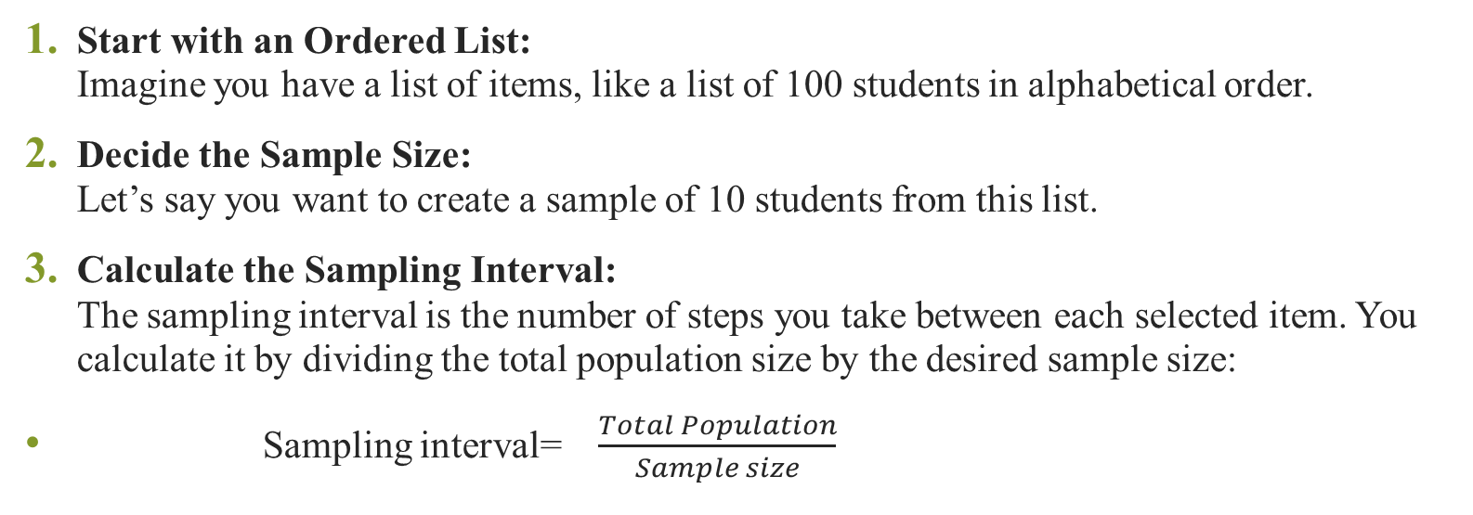
How systematic sampling works
Start with an Ordered List:
Imagine you have a list of items, like a list of 100 students in alphabetical order.
Decide the Sample Size:
Let’s say you want to create a sample of 10 students from this list.
Calculate the Sampling Interval:
The sampling interval is the number of steps you take between each selected item. You calculate it by dividing the total population size by the desired sample size:
Sampling interval= $\frac{Total Population}{Sample size}$

Slide 30
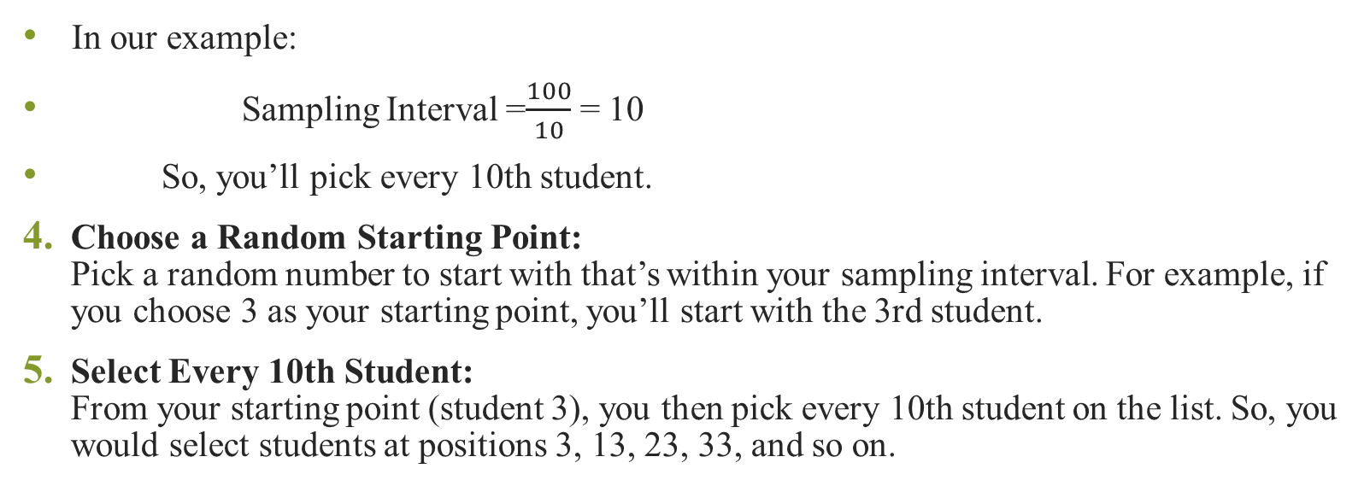
How systematic sampling works
In our example:
Sampling Interval =$\frac{100}{10}$ = 10
So, you’ll pick every 10th student.
Choose a Random Starting Point:
Pick a random number to start with that’s within your sampling interval. For example, if you choose 3 as your starting point, you’ll start with the 3rd student.
Select Every 10th Student:
From your starting point (student 3), you then pick every 10th student on the list. So, you would select students at positions 3, 13, 23, 33, and so on.

Slide 31
Example
Suppose you want to obtain a systematic sample of 8 houses from a street of 120 houses., so
First, since 120/8=15,
choose a random starting point between 1 and 15.
Let’s say, 11.
Then, choose every 15th house after the 11th house. The list of houses selected are 11, 26, 41, 56, 71, 86, 101, and 116.

Slide 32
Stratified sampling
Population is divided into mutually exclusive groups and random samples are drawn from each group.
Divide the population into sub groups (called strata) and based on relevant characteristics (eg: gender, age range, income bracket, job role etc)
Mutually exclusive means If one particular element is present in one group then it cannot be part of other group

Slide 33
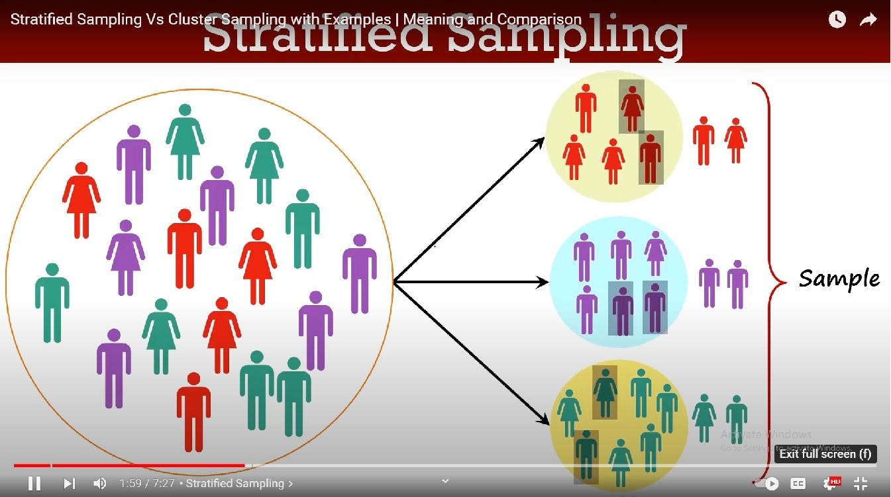
Stratified sampling

Slide 34
Proportional sampling
Proportional sampling, also known as quota sampling,
Proportional Sampling: Key Steps
Divide the Population: Split the population into distinct groups (strata) based on specific characteristics like age, gender, or income
Proportional Selection: Select samples from each group in proportion to their size in the overall population (e.g., if a group is 20% of the population, it should make up 20% of the sample).
Random Selection: Randomly choose individuals or items within each group to ensure the sample is unbiased and representative.

Slide 35
Example
Male, full time | 90
Male, part time | 18
Female, full time | 9
Female, part time | 63
Suppose that in a company there are 180 staff include
we are asked to take a proportional sample of 40 staff,
stratified according to the above categories.
The first step is to calculate the percentage of staff in each group

Slide 36
Cluster sampling
Create a sample from large population by grouping population into cluster.
Then randomly selecting some of these clusters for study
Group the population into cluster
The entire population is divided into smaller groups called clusters.
While forming a cluster keep in mind that each population cluster is highly diversed so that all the characteristics of the population can be represented
Each cluster should have similar distribution of characteristics as a distribution of population.
Further there should not be any overlapping between the cluster(i.e. mutually exclusive elements)
When taken together cluster should cover the whole population

Slide 37
Cluster sampling
Randomly Select Clusters: Instead of picking individuals from every group, only a few clusters are randomly chosen for the sample
Choose the Sample from Clusters: Once the clusters are selected, you either include all the individuals or items from those clusters in your sample, or you randomly select a certain number of individuals from each chosen cluster.
Key Difference from Stratified Sampling?

Slide 38
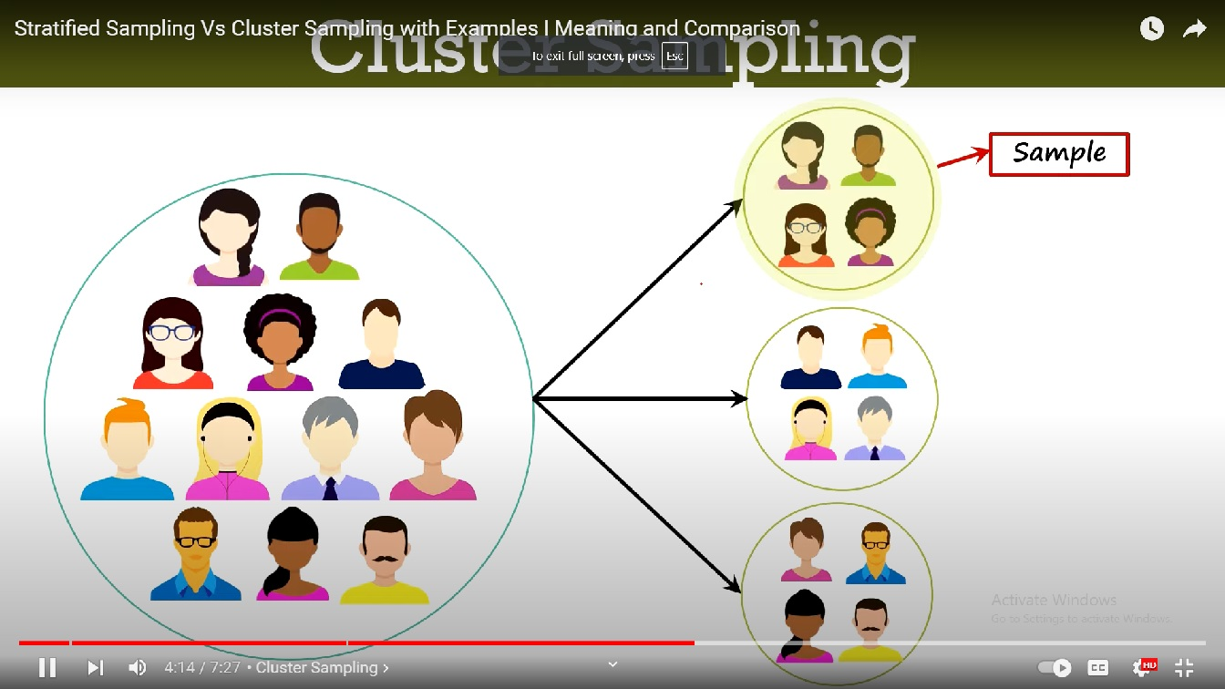
Cluster sampling

Slide 39
Probability & statistics
Probability is the science of making statement about what will occur when samples are drawn from a known population.
Example: Imagine you have a jar with 100 marbles, 70 of which is red, 30 are blue. If you randomly pick one marble then what is the probability that it is red?
Statistics is the science of organizing a sample data and making inferences about the unknown population from which the sample is drawn.
Example: You don’t know the actual proportion of red and blue marbles in the jar. You take random sample of 10 marble and find that 7 are red and 3 are blue. Based on this sample you might infer that 70% of the marbles are red.

Slide 40
How probability supports statistics
Probability helps us to understand how likely it is our statistical conclusions are accurate. It provides way to measure the reliability of our inferences from sample to the entire population.
Example: If you repeatedly take sample of 10 marbles from the jar, you might find that results vary a little each time. Probability allows you to calculate how likely it is that sample(e.g. 7 red marbles out of 10) reflects true proportion of red marbles in the jar. It helps to justify accuracy of your conclusion

Slide 41
Comparison of probability and statistics
Probability : Characteristics of the population are already known. For example you might known that 60% of the marbles in the jar are red.
Probability answers questions about samples: It calculates likelihood of certain outcomes when taking sample from this known population. For e.g if you pick 10 marbles form the jar probability can tell you the chance that exactly 6 of them will be red.
Statistics does not assume the population properties known. Instead it uses data from samples to draw conclusion.
Statistics draws conclusion about the population from sample that is drawn

Slide 42
Sampling errors
Generalizing from sample to population may led to error.
While sampling is powerful its not perfect.
Two common types of errors in sampling is selection Bias and sampling Error
Selection Bias: Caused when the method of drawing observations skews the sample in some way
Sampling Error: Caused due to the random nature of drawing observations skewing the sample in some way

Slide 43
Statistical re sampling
Resampling is a statistical technique used to estimate the population parameter(such as the mean or population) by repeatedly sampling from your data you already have.
Problem: Single estimate of the population parameter
When you collect sample from population and calculate a parameter(like mean , sd), you only get one estimate, which does not give you idea about how much data will vary if you took different sample.
You also don ‘t no how close is your estimate is true for entire population value

Slide 44
How resampling helps
Solution
Estimate the population parameter multiple times
To address the uncertainty of having just one estimate , you can use technique called re-sampling. It involves repeatedly taking samples from your original data.
Understanding variability
Building confidence

Slide 45
Advantages and Disadvantages of resampling
Advantages:
Easy to use
Requires little mathematical knowledge
Easy to understand and implement
Disadvantages:
Computationally expensive

Slide 46
Different statistical re sampling methods
Bootstrap resampling:
Samples are drawn from the dataset with replacement (allowing the same sample to appear more than once in the sample), where those instances not drawn into the data sample may be used for the test set.
k-fold Cross-Validation:
A dataset is partitioned into k groups, where each group is given the opportunity of being used as a held
Notes:
Real-Life Example (Bootstrap)
Scenario: Imagine you're a baker trying to estimate the average weight of cookies you bake. You have a batch of 100 cookies, and you randomly select 10 cookies to measure their weight. In bootstrap resampling, you might select one cookie, measure its weight, put it back in the batch, and then pick another (possibly the same cookie again). You do this until you have a sample of 10 cookies.
Purpose: By repeating this process many times, you generate multiple samples of 10 cookies each. This helps you understand how much the average weight might vary and gives you a better estimate of the true average weight for all the cookies you bake.
k-fold Cross-Validation
Explanation: In k-fold cross-validation, you divide your dataset into k equal parts or "folds." You then train your model on k-1 folds (using them as the training set) and test it on the remaining fold (the test set). This process is repeated k times, with each fold being used as the test set once. The performance of the model is then averaged across all k trials.
Real-Life Example:
Scenario: Suppose you're a teacher evaluating a new teaching method. You have test scores from 100 students and want to predict future student performance. You divide the students into 5 groups (k=5). You then train your model on 4 groups and test it on the 5th group to see how well your model predicts their scores.

Slide 47
Difference between sampling and resampling technique
Sampling methods | Re-sampling methods
It is used to collect data from a larger population to make inferences about that population. | Used to analyze the variability of statistics, estimate confidence intervals, or validate models using the already collected data.
Involves selecting data from the original population. | Involves selecting data from the existing sample or dataset.
Methods focus on how to obtain the initial subset from the population (e.g., random sampling, stratified sampling). | Methods focus on repeatedly drawing subsets from the existing data to perform statistical analyses (e.g., bootstrap, cross-validation).
Depending on the method, samples may be drawn with or without replacement from the population. | Techniques like bootstrap specifically involve sampling with replacement from the existing dataset.

